Slide 1


IFS233 – 2025 Unit 6 – Part 3
Project Schedule Management

Slide 2

Program Evaluation and Review Technique (PERT)
PERT is a network analysis technique used to estimate project duration when there is a high degree of uncertainty about the individual activity duration estimates
PERT weighted average duration CPM
PERT uses probabilistic time estimates
duration estimates based on using optimistic, most likely, and pessimistic estimates of activity durations, or a three-point estimate
By using the PERT weighted average for each activity duration estimate, total project duration estimate takes into account the risk or uncertainty in the individual activity estimates
Advantage: addresses the risk associated with duration estimates (more realistic durations).
Disadvantage: involves more work than CPM

Slide 3
PERT Formula and Example
PERT weight average =
optimistic time + 4 x most likely time + pessimistic time
6
Example:
PERT weight average =
8 workdays + 4 x 10 workdays + 24 workdays = 12 days 6
where optimistic time= 8 days
most likely time = 10 days, and
pessimistic time = 24 days
Therefore, you’d use 12 days on the network diagram instead of 10 when using PERT for the above example

Slide 4
PERT exercise 1
Suppose a project manager estimates that the most likely time to complete a project is 12 days--assuming predictable delays and ignoring unlikely scenarios that will either decrease or increase the time. Her optimistic prediction for the project is 7 days--assuming that there are none of the usual delays. Her pessimistic prediction for the project is 29 days--assuming that all possible delays occur.
The PERT estimate for the duration of the project is ____.
Use the formula to compute the duration.

Slide 5
PERT Exercise 2
Your team members told you that an activity you are working on is most likely to be completed in 20 days. However, in the worst case it might take 30 days, and if all conditions are favourable, it might be completed in 15 days.
Question: Determine the PERT Time estimate (round to nearest integer).

Slide 6
Exercise 2 - Solution
Solution
To determine the PERT estimate, we need the Optimistic Time, Pessimistic Time, and Most Likely Time for the activity.
The question says it is most likely that the task can be completed in 20 days, hence: Most Likely Time = 20 days
It further says that in the worst case it may take 30 days, hence: Pessimistic Time = 30 days
It also says that if all conditions are favourable, it will take 15 days to complete the task. Hence: Optimistic Time = 15 days
Now,
PERT Estimate = [Optimistic Time + 4 X (Most Likely Time) + Pessimistic Time] / 6
= [15 + 4X20 + 30] / 6 = [15 + 80 + 30] / 6 = 125 / 6 = 20.83 days
Hence, PERT estimate for this activity is 21 days. Rounded to the nearest integer.

Slide 7
Exercise 3
Consider the following project tasks and their identified best, likely, and worst case estimates of task duration (in weeks). Assume the organization you work for computes PERT weight average based on the standard formula. Calculate the PERT weight average for each of the following tasks (round to the nearest interger):
Activity | Best | Likely | Worst | Average
A | 5 | 5 | 20
B | 3 | 5 | 9
C | 7 | 21 | 26
D | 4 | 4 | 4
E | 10 | 20 | 44
F | 3 | 15 | 15
G | 6 | 9 | 11
H | 32 | 44 | 75
I | 12 | 17 | 31
J | 2 | 8 | 10

Slide 8
Exercise 3 - Solution
Consider the following project tasks and their identified best, likely, and worst case estimates of task duration. Assume the organization you work for computes PERT weight average based on the standard formula. Calculate the PERT weight average for each of the following tasks (round to the nearest interger):
Activity | Best | Likely | Worst | Average
A | 5 | 5 | 20 | 8
B | 3 | 5 | 9 | 5
C | 7 | 21 | 26 | 20
D | 4 | 4 | 4 | 4
E | 10 | 20 | 44 | 22
F | 3 | 15 | 15 | 13
G | 6 | 9 | 11 | 9
H | 32 | 44 | 75 | 47
I | 12 | 17 | 31 | 19
J | 2 | 8 | 10 | 7

Slide 9
Exercise 4
An advertising project manager has developed a program for a new advertising campaign. In addition, the manager has gathered the time information for each activity, as shown in the table below.
Calculate the PERT weight average for the activities (round to nearest integer)
Draw an AON network diagram and calculate activity floats (Total & Free). What is the total project length? Make sure you fully label all nodes in the network.
Identify the critical path. What are the alternative paths?
Identify the “burst” activities and the “merge” activities.
 | Time Estimates (Weeks)
Activity | Optimistic | Most Likely | Pessimistic | PERT Average | Immediate Predecessors (s)
A | 1 | 4 | 7 |  | ---
B | 2 | 6 | 7 |  | ---
C | 3 | 3 | 6 |  | B
D | 6 | 13 | 14 |  | A
E | 3 | 6 | 12 |  | A,C
F | 6 | 8 | 16 |  | B
G | 1 | 5 | 6 |  | D,E,F

Slide 10
Exercise 4 - Solution
An advertising project manager has developed a program for a new advertising campaign. In addition, the manager has gathered the time information for each activity, as shown in the table below.
Calculate the PERT weight average for the activities (round to nearest integer)
Draw an AON network diagram and calculate activity floats (Total & Free). What is the total project length? Make sure you fully label all nodes in the network.
Identify the critical path. What are the alternative paths and how much float time is associated with each “feeder path?”
Identify the “burst” activities and the “merge” activities.
 | Time Estimates (Weeks)
Activity | Optimistic | Most Likely | Pessimistic | PERT Average | Immediate Predecessors (s)
A | 1 | 4 | 7 | 4 | ---
B | 2 | 6 | 7 | 6 | ---
C | 3 | 3 | 6 | 4 | B
D | 6 | 13 | 14 | 12 | A
E | 3 | 6 | 12 | 7 | A,C
F | 6 | 8 | 16 | 9 | B
G | 1 | 5 | 6 | 5 | D,E,F

Slide 11
Exercise 4 - Solution
Activity | Predecessor | Duration
A | --- | 4
B | --- | 6
C | B | 4
D | A | 12
E | A,C | 7
F | B | 9
G | D,E,F | 5
Total project length: 6+4+7+5 = 22 Weeks
Critical path (3): B-C-E-G (6+4+7+5) = 22 Weeks
Other paths are:
Path 1: A-D-G (4+12+5) = 21 Weeks
Path 2: A-E-G (4+&+5) = 17 Weeks
Path 4: B-F-G (6+9+5) = 20 Weeks
Burst activities: A & B
Merge activities: E & G
TF=1
4 | D | 16
5 | 12 | 17
TF=1
FF=1
TF=0
0 | A | 4
1 | 4 | 5
TF=0
17 | G | 22
17 | 5 | 22
10 | E | 17
10 | 7 | 17
TF=0
FF=0
6 | C | 10
6 | 4 | 10
FF=0
TF=0
0 | B | 6
0 | 6 | 6
FF=0
TF=2
6 | F | 15
8 | 9 | 17
FF=0
FF=2

Slide 12
Revision - Exercise 5
Using the following information, create an AON network activity diagram, calculate each activity PERT average (PA) (rounding to the nearest integer), the total duration of the project, its early start, early finish, late start and late finish times, floats (Free and total) for each activity. Finally, show the project’s critical path. c
Activity | Preceding activities | Optimistic | Most Likely | Pessimistic | PERT Average
A | -- | 12 | 15 | 25 | 16
B | A | 4 | 6 | 11 | 7
C | -- | 12 | 12 | 30 | 15
D | B,C | 8 | 15 | 20 | 15
E | A | 7 | 12 | 15 | 12
F | E | 9 | 9 | 42 | 15
G | D,E | 13 | 17 | 19 | 17
H | F | 5 | 10 | 15 | 10
I | G | 11 | 13 | 20 | 14
J | G,H | 2 | 3 | 6 | 3
K | J,I | 8 | 12 | 22 | 13

Slide 13
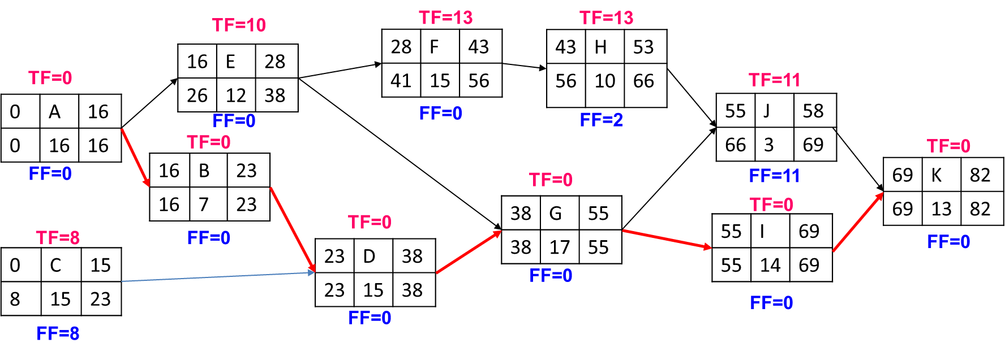
Exercise 5 - Solution
FF=0
Total duration of the project is 82 days
Critical path: A-B-D-G-I-K

Slide 14
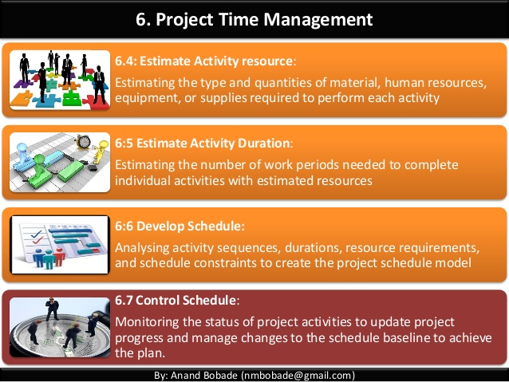
(6) Controlling the Schedule
Inputs
Tools & Techniques
Outputs
Project
management plan
Performance reviews
Critical path methods
Schedule change control system
Ms Project software
Variance analysis
Adjusting leads and lags etc.
Work performance measurements
Project schedule
Work performance data
Organizational processes assets updates e.g. Lesson-learned reports,
Project
calendars
Schedule data
Organizational processes assets
Plan Schedule
Define Activities
Sequence Activities
Estimate Activity
Durations
Develop Schedule
Control
Schedule

Slide 15
(6) Controlling the Schedule
Goals are to know the status of the schedule, influence factors that cause schedule changes, determine that the schedule has changed, and manage changes when they occur
Tools and techniques include
Progress reports
A schedule change control system
Project management software, including schedule comparison charts like the tracking Gantt chart
Variance analysis, such as analyzing float or slack
Performance management, such as earned value (chapter 7)
Plan Schedule
Define Activities
Sequence Activities
Estimate Activity
Durations
Develop Schedule
Control
Schedule

Slide 16
Reality Checks on Scheduling
First review the draft schedule or estimated completion date in the project charter
Prepare a more detailed schedule with the project team
Make sure the schedule is realistic and followed
Alert top management well in advance if there are schedule problems

Slide 17
Using Software to Assist in Project Schedule Management
Software for facilitating communications helps people exchange schedule-related information
Decision support models help analyze trade-offs that can be made to address schedule issues
Project management software can help in various time management areas

Slide 18
Words of Caution on Using Project Management Software
Many people misuse project management software because they don’t understand important concepts and have not had training
Example: dependencies must be entered to have dates adjust automatically and to determine the critical path
Many project management software programs come with templates or sample files
It is very easy to use these files without considering unique project needs
Project managers and their teams should be careful not to rely too much on templates or sample files and ignore the unique concerns of their particular projects

Slide 19
Considerations for Agile/Adaptive Environments
Schedule management is radically different using Agile and Scrum
Projects that rely heavily on the critical path method consider meeting the project’s estimated completion date as a crucial component of success
Agile projects may not even need to estimate activity durations or project schedules at all; overall project completion time is not important

Slide 20

STUDENT EXERCISES
Sharpen your pencil

Slide 21
EXERCISE 1
Draw an AON network diagram and clearly label on the diagram, the earliest and latest start and finish times and float (TF & FF) of each task
Find the total and free floats
Identify the critical path
Activity | Duration | Precedence
A | 3 | -
B | 2 | A
C | 1 | A
D | 1 | A
E | 3 | B,C
F | 2 | D
G | 1 | E
H | 2 | E,F
I | 2 | G,H

Slide 22
EXERCISE 2
Draw an AOA network diagram and Identify the critical path
Activity | Predecessor | Duration (Weeks)
A | --- | 5
B | A | 8
C | B,E | 7
D | C | 2
E | --- | 9
F | E | 3
G | F,I | 5
H | --- | 4
I | H | 6
J | I | 5
K | J | 3

Slide 23
EXERCISE 3
Draw an AOA network diagram and identify the critical path and alternative paths.
Activity | Predecessor | Duration (Weeks)
A | --- | 6
B | A | 7
C | B,E | 9
D | C | 11
E | --- | 1
F | E | 4
G | F,I | 7
H | --- | 6
I | H | 3
J | I | 9
K | J | 8

Slide 24
EXERCISE 4
Your company has decided that it needs a new sales recording system and that an off-the-shelf package is the best solution. The main tasks have been identified and durations assessed as follows: (20)
Activity | Activity Description | Weeks
A | Draw up a functional Requirements specification | 5
B | Consider various relevant software packages and select one | 3
C | Identify and specify the necessary hardware and communications equipment | 2
D | Order the hardware and equipment | 1
E | Identify the key package modifications needed to meet the functionality required | 3
F | Modify the software package as necessary | 8
G | Accept delivery and install all hardware and equipment needed for the package | 10
H | Design a training plan | 4
I | Set up a testing plan | 3
J | Unit test all the amended package modules | 5
K | Train the users | 4
L | Full integration and acceptance testing | 3
M | Implement the new system | 2
Consider the following information:
B cannot start until A is completed
C, E, H and I cannot start until B is completed
D cannot start until C is completed
F cannot start until E is completed
G cannot start until D is completed
J cannot start until F, G and I are completed
K cannot start until H is completed
L cannot start until J and K are completed
M cannot start until L is completed
Question:
Draw an activity-on-node diagram for these 13 project tasks (A to M). Calculate, display and clearly label on the diagram, the earliest and latest start and finish times and float (TF & FF) of each task (11 Marks)

Slide 25
EXERCISE 5
Use the information to draw a full Activity on Node (AON) diagram for the project. Calculate the Forward Pass (ES & EF) and Backward Pass (LS & LF) for the project. Identify the critical path, total float (TF) and free float (FF)
ACTIVITY | PREDECESSOR | DURATION (Days)
A | --- | 8
B | --- | 15
C | --- | 10
D | A | 10
E | A | 12
F | E | 5
G | B,C,F | 10
H | C | 20
I | D,E | 15
J | E,G,I | 7
K | H, J | 8
L | H | 10

Slide 26
EXERCISE 6
Consider the below information:
Use the PERT formula to calculate PERT Weighted average and round off the duration estimates into the nearest integer. Time estimates is in days
Draw an AON and calculate the ES;EF;LS;LF using forward and backward pass.
Calculate floats for each activity
ACTIVITY | DESCRIPTION | OPTIMISTIC | MOST LIKELY | PESSIMISTIC | PERT WEIGHTED AVERAGE
A | Determine new product features | 4 | 5 | 12 | 6
B | Acquire prototype materials | 16 | 20 | 30 | 21
C | Produce prototype | 8 | 10 | 12 | 10
D | Design marketing campaign | 9 | 10 | 14 | 11
E | Design graphics | 6 | 10 | 20 | 11
F | Conduct marketing | 28 | 30 | 50 | 33
G | Perform sales calls | 20 | 25 | 30 | 25

Slide 27
EXERCISE 7
Consider a project with the following information:
Construct the project activity network using AON methodology and label each node
Identify the critical path and other paths through the network
ACTIVITY | DURATION | PREDECESSORS
A | 3 | --
B | 5 | A
C | 7 | A
D | 3 | B,C
E | 5 | B
F | 4 | D
G | 2 | C
H | 5 | E,F,G

Slide 28
EXERCISE 8
Consider a project with the following information:
Construct the project activity network using AON methodology and label each node
Identify the critical path and other paths through the network
Activity | Duration | ES | EF | LS | LF | Float (TF)
A | 3 | 0 | 3 | 0 | 3 | 0
B | 5 | 3 | 8 | 5 | 10 | 2
C | 7 | 3 | 10 | 3 | 10 | 0
D | 3 | 10 | 13 | 10 | 13 | 0
E | 5 | 8 | 13 | 12 | 17 | 4
F | 4 | 13 | 17 | 13 | 17 | 0
G | 2 | 10 | 12 | 15 | 17 | 5
H | 5 | 17 | 22 | 17 | 22 | 0

Slide 29
Chapter Summary
Project time management is often cited as the main source of conflict on projects, and most IT projects exceed time estimates
Main processes include
Plan schedule management
Define activities
Sequence activities
Estimate activity resources
Estimate activity durations
Develop schedule
Control schedule

